Slide 1
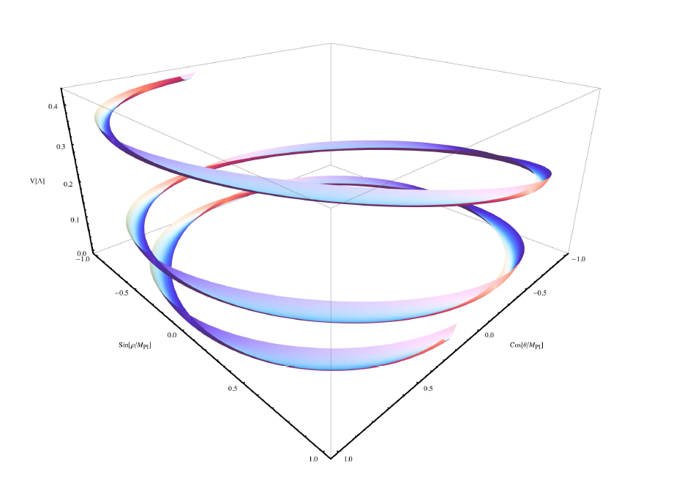
Aligned Natural Inflation
13. June in Kobe
Ippei Obata
Ref)K. Freese, J.A.Frieman and A.V.Olinto, Phys.Rev.Lett. 65 (1990) 3233-3236
Rolf Kappl, Sven Krippendorf and Hans Peter Nilles, [arXiv:1404.7127 [hep-th]]

Slide 2
Table of Contents
Introduction
Natural Inflation
Aligned Natural Inflation
Summary

Slide 3
Table of Contents
Introduction
Natural Inflation
Aligned Natural Inflation
Summary

Slide 4
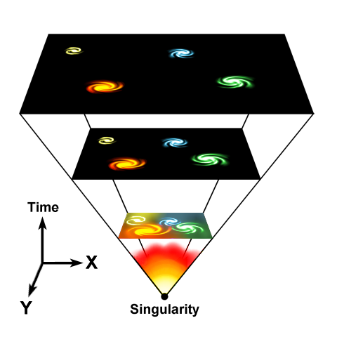
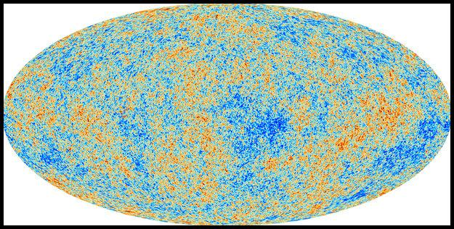
Historical review
There were some conceptual problems of the standard big bang model.
Ex)
the horizon problem, the flatness problem, the monopole problem etc.
The “Inflationary universe” was proposed!

Slide 5
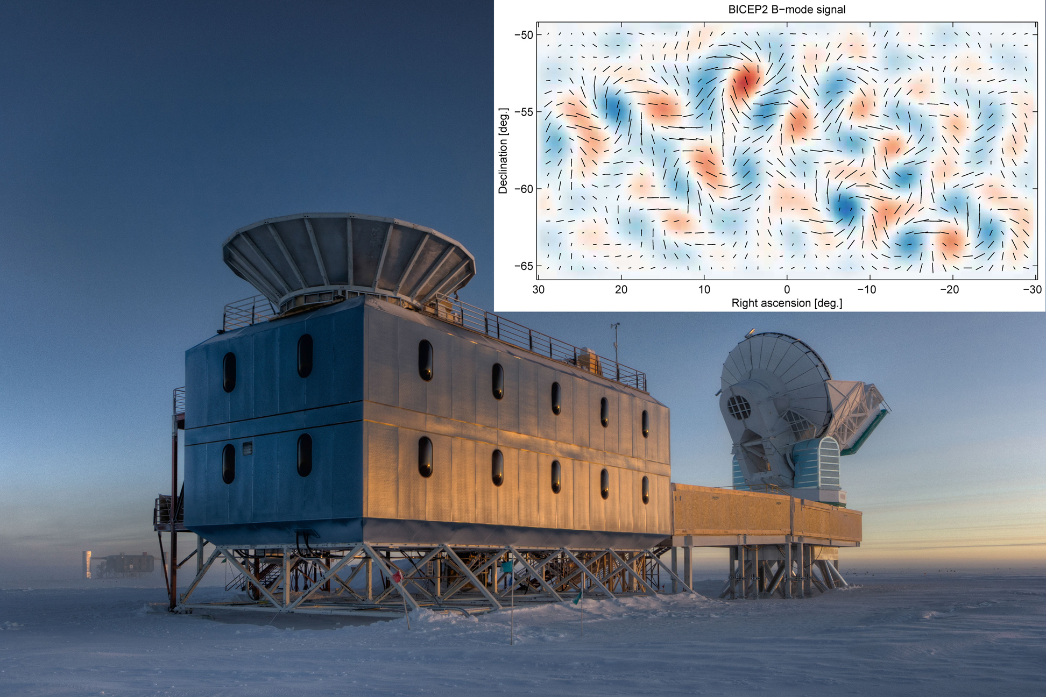
The Inflationary Paradigm
The best idea explaining the early universe!
BICEP2 detects the evidence of inflationary era!?

Slide 6
During the Inflation…
The vacuum energy density is dominated:
The cosmological metric is:
Our Universe grows sufficiently:

Slide 7
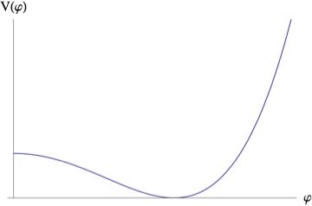
The Mechanism of the Inflation
The “inflaton” plays an important role:
The potential must be very flat:
very small!

Slide 8
The interpretation on λ
Why is so small number ?:
We want to consider the inflation scenario which can derive such a small dynamically in particle-physics models!
The “axionic inflation” is proposed . (Natural Inflation)

Slide 9
The result of BICEP2
The tensor-scalar ratio is:
Quantum gravitational effects might destroy the flatness of the inflaton potential!
The axionic inflation might avoid such a problem!

Slide 10
Table of Contents
Introduction
Natural Inflation
Aligned Natural Inflation
Summary

Slide 11
What is “axion”?
A very light, weakly interacting scalar particle appearing in the framework of QCD, string theory etc.
One of the candidates of dark matter in cosmology
Has a flat potential as a result of shift symmetry! (in classical level)

Slide 12
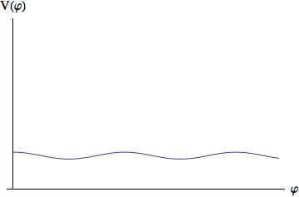
What is “axion”?
However…
We don’t want the exactly flat potential.
The axion has additional explicit symmetry breaking.(quantum effects!)

Slide 13
Ex) The QCD axion
The strong CP problem:
In the experiment,
breaks the CP symmetry
the CP symmetry is strongly conserved!
We expect some mechanisms such as:

Slide 14
Ex) The QCD axion
In QCD Lagrangian, the Yukawa terms are included:
We introduce a new symmetry in the QCD Lagrangian:

Slide 15
Ex) The QCD axion
By quantum effects, the parameter transforms:
Then, the axion potential become:
So, we can set:

Slide 16
Natural Inflation
The potential is:
The axion slowly rolls on the potential

Slide 17
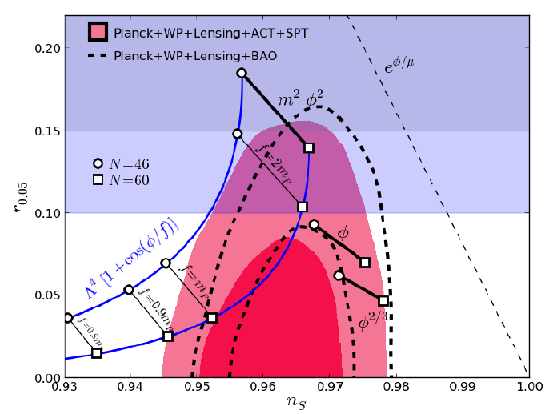
The successful BICEP2 constraints
For parameters:
K.Freese and W.H.Kinney [arXiv:1403.5277v3 [astro-ph.CO]]
( Satisfied!)
We have shown the flatness of the potential naturally!

Slide 18
The problem is…
The condition is not good for the effective theory of the superstring:
In the framework of string theory, various axion candidates might be provided.
We explore the two axion model!
(Aligned Natural Inflation)

Slide 19
Table of Contents
Introduction
Natural Inflation
Aligned Natural Inflation
Summary

Slide 20
A two axion field model
The Lagrangian density is:
There is a flat direction if the following relation holds:

Slide 21
Make the potential for inflation
Breaking this flat direction by :
The potential can be found:
Rolf Kappl, Sven Krippendorf and Hans Peter Nilles, [arXiv:1404.7127 [hep-th]]

Slide 22
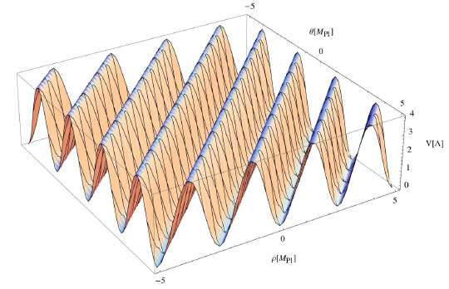
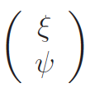
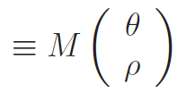
The effective Natural Inflation
We can find the suitable basis:
Near the origin with ,
match with…

Slide 23
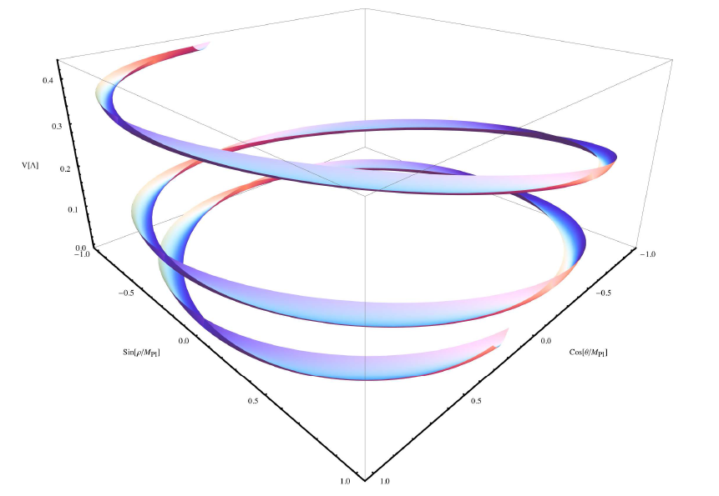
Parametric plot of the potential
For parameters
Rolf Kappl, Sven Krippendorf and Hans Peter Nilles, [arXiv:1404.7127 [hep-th]]

Slide 24
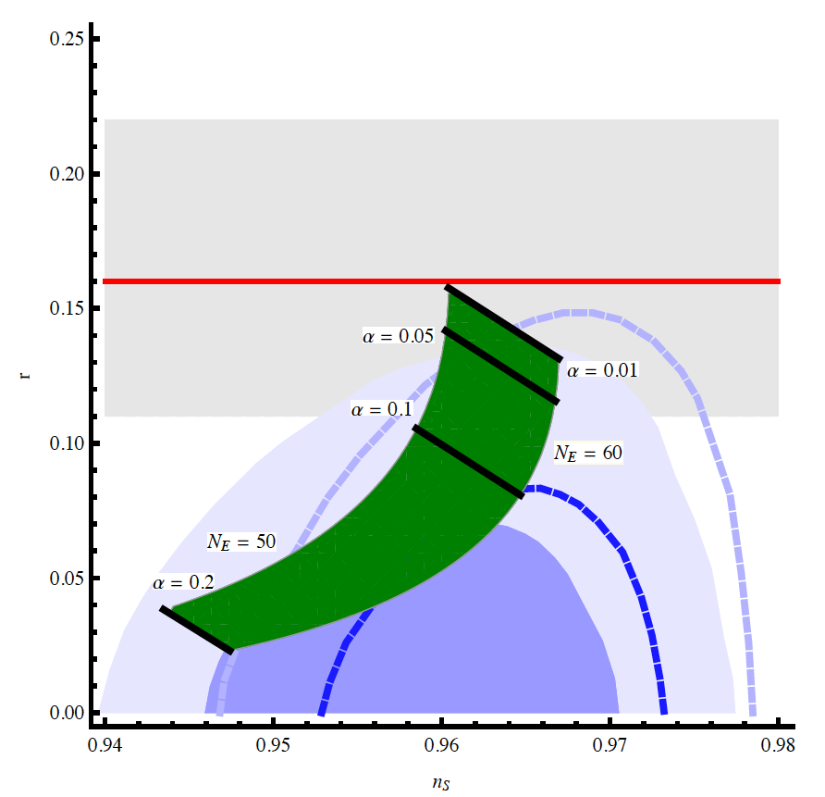
The successful BICEP2 constraint
The ns-r-plane profile is:
(On the other hand, )
Rolf Kappl, Sven Krippendorf and Hans Peter Nilles, [arXiv:1404.7127 [hep-th]]

Slide 25
Table of Contents
Introduction
Natural Inflation
Aligned Natural Inflation
Summary

Slide 26
Summary
We have illustrated the flatness of the inflaton potential through (Aligned) Natural Inflation scenario.
It is worthwhile to research some related axionic models from the phenomenological point of view.
String, Extra dimension, …

