Slide 1
Cosmological implications of quantum entanglement in the multiverse
Sugumi Kanno (University of the Basque Country)
based on
arXiv:1405.7793 [hep-th]; JCAP 1407 (2014) 029
arXiv:1506.07808 [hep-th]

Slide 2
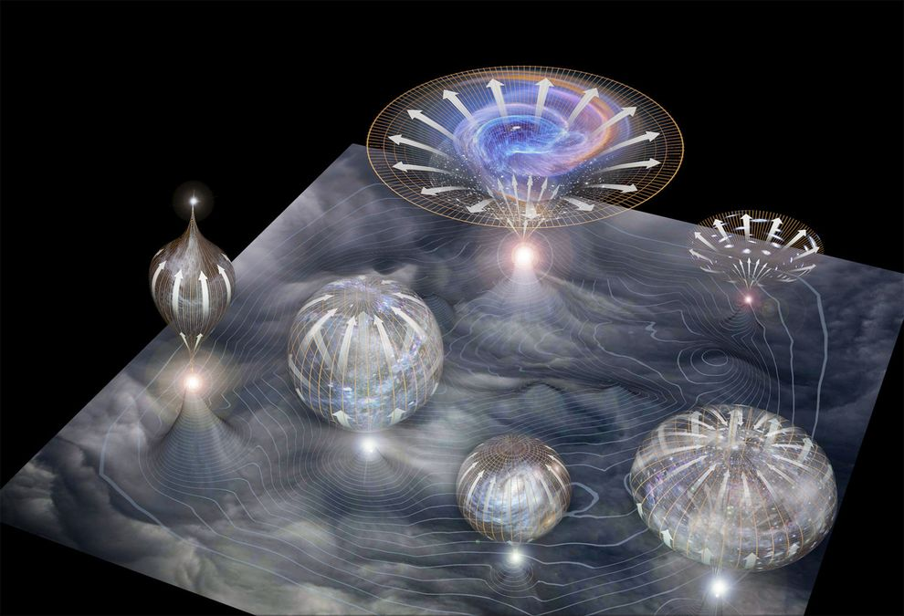
Inflationary cosmology/String landscape
Inflationary cosmology/String landscape suggest that our universe may not be the
only universe but is part of a vast complex of universes that we call the multiverse.
Our universe
the universe out there
© National Geographic
Is our universe is entangled with the universe out there?
Can we detect observable signatures?
Can we confirm the existence of other universes?

Slide 3
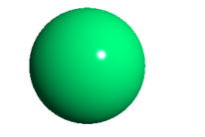
Quantum entanglement?
The most mysterious aspect of quantum entanglement would be to affect the
outcome of local measurements instantaneously beyond the lightcone once a
local measurement is performed: Einstein-Podolsky-Rosen paradox.
Quantum entanglement could exist beyond the Hubble horizon.
the universe out there
A pair of particles created within a causally connected,
Hubble horizon size region
time
Our universe
There might be a copy of our universe out there !?
de Sitter space

Slide 4
De Sitter space and the Penrose diagram
Two causally separated open charts in de Sitter space
Time slice in open chart
de Sitter space
Open chart

Slide 5
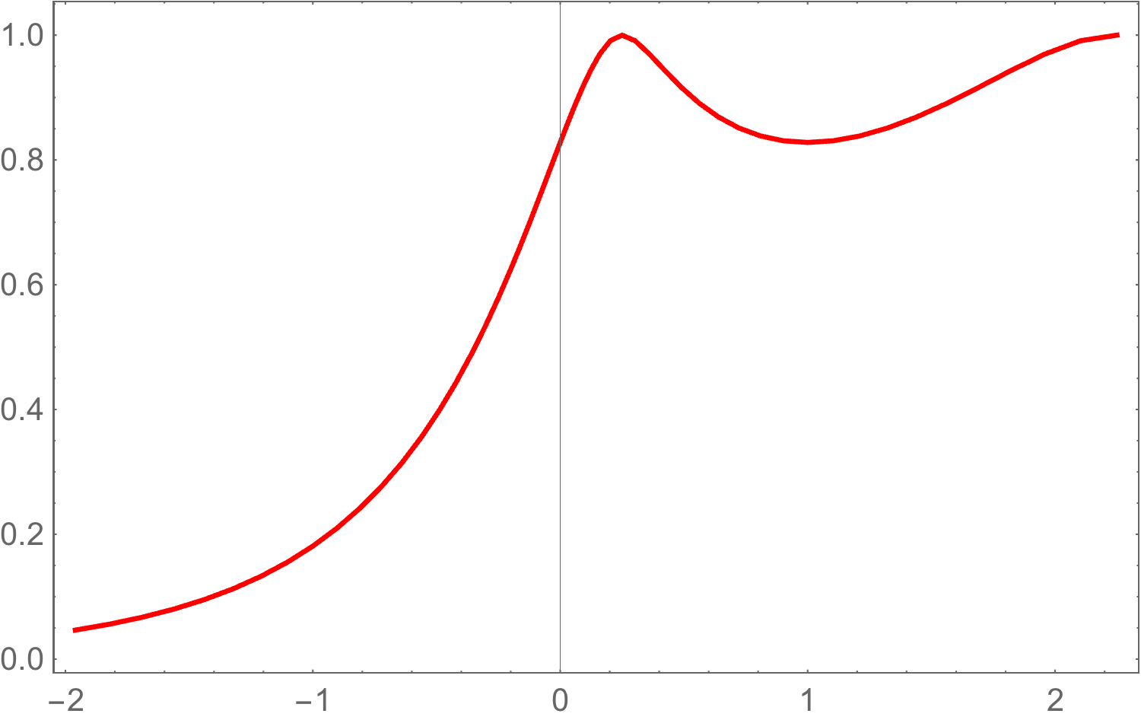
Entanglement entropy between R and L regions
Maldacena & Pimentel (2013)
Two causally disconnected regions are shown to be entangled.
Entanglement entropy :
Reduced density matrix
Vacuum fluctuations observed in our universe may
be entangled with those in the universe out there.
conformally flat
massless
Scalar mass parameter
Large mass
Small mass

Slide 6

Open chart for bubble nucleation
Open Universe
False vacuum
Tunneling
Minkowski
Action (a test scalar field)
No bubble wall
False Vacuum
(Euclid space)
Bubble wall
Metric
The Hubble radius² of the de Sitter space
Separation of variables
Harmonic functions on the 3-dim hyperbolic space

Slide 7
Solutions
EOM
Sasaki, Tanaka & Yamamoto (1995)
The Laplacian operator on the unit 2-sphere
Solutions supported both on the R and L regions
Initial state: The Bunch-Davies vacuum
The associated Legendre functions
1 line

Slide 8
Fourier mode field operator
Fourier mode field operator
If we introduce a matrix
: The capital indices (I, J ) run from 1 to 4
Then, the Fourier mode field operator is expanded as

Slide 9
Spectrum in the L region
The matrix is
reduced to
: The calligraphic indices run from 1 to 2
Then, the Fourier mode field operator is expanded as
The mean-square vacuum fluctuations

Slide 10
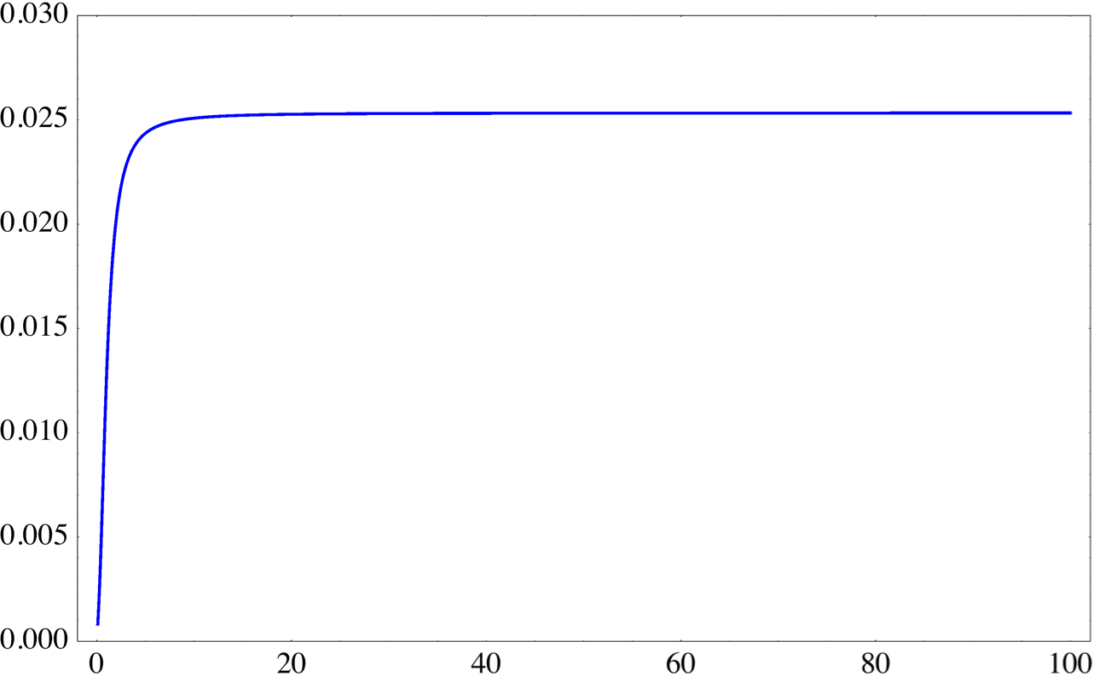
Power spectrum
The normalized spectrum per unit logarithmic interval of
No time dependence
This is the well-known result for vacuum fluctuations after horizon exit.
The vacuum fluctuations get frozen out after horizon exit.

Slide 11
What happens to the spectrum, if we were
ignorant about the existence of the region R?
We had known the existence of the region R
We are here
No access
False Vacuum
(Euclid space)
Calculate the spectrum by using the reduced density matrix.

Slide 12
Derivation of reduced density matrix in the region L
Maldacena & Pimentel (2013)
We need to trace over the degrees of freedom of the region R.
The reduced density matrix has to be diagonalized.
Again, the Fourier mode field operator is
Positive freq. in the past in the Bunch-Davies vacuum
Positive freq. in the past in each R or L vacua
The relation between and has to be

Slide 13
Reduced density matrix
The Bogoliubov transformation: from the Bunch-Davies vacuum to the R,L - vacua
Symmetric matrix which we want to know
The condition determines
Conformal invariance ( )
Masslessness ( )
Unimporatant phase factors
The density matrix is not diagonal in the basis.
We perform another Bogoliubov transformation.

Slide 14
Reduced density matrix
Another Bogoliubov transformation
to obtain the relation
we want to know
The consistency condition
Conformal invariance ( )
determines
Masslessness ( )
Finally, the reduced density matrix is found to be diagonalized as
: Thermal state

Slide 15
Spectrum of vacuum fluctuations
The Fourier mode field operator is expanded as
Kanno (2014)
The mean-square vacuum fluctuations (a single mode)
as
for the massless scalar field
The effect of tracing out the degrees of freedom of the region R
This extra term enhances the mean-square vacuum fluctuations at long wavelengths.

Slide 16
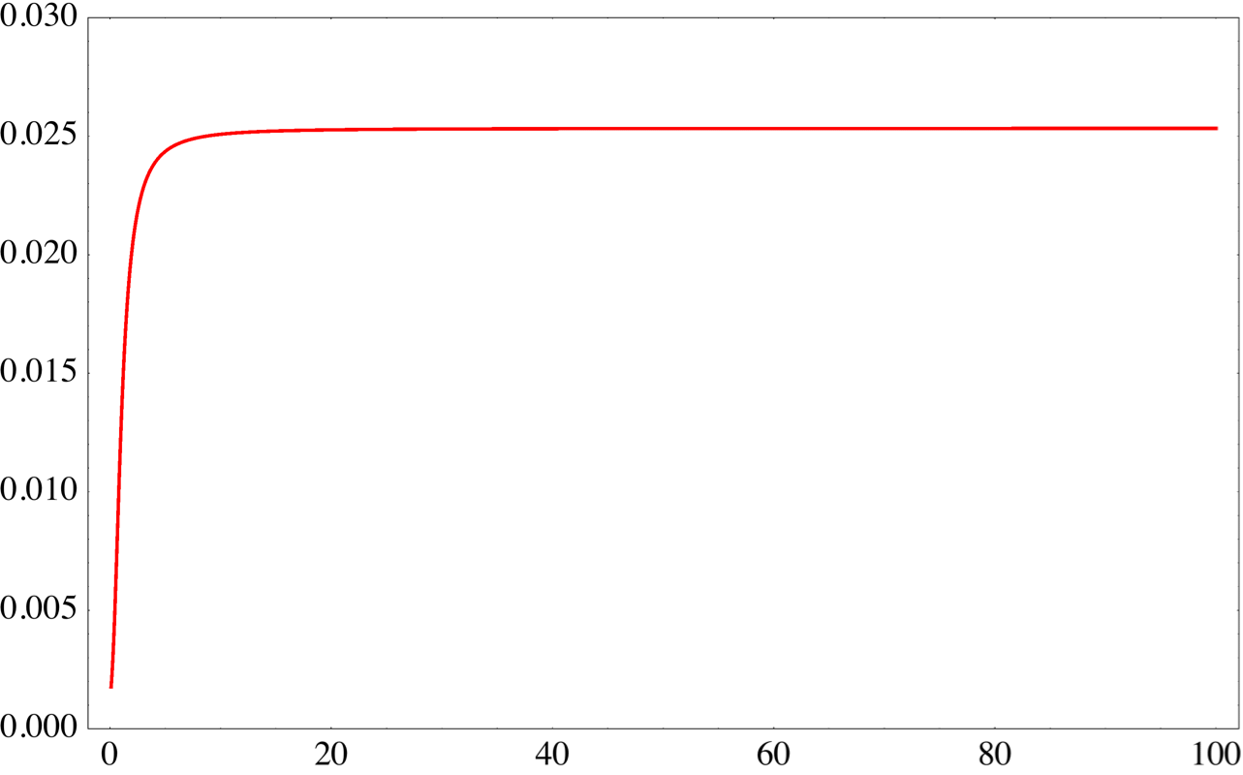
Power spectrum
The spectrum of the vacuum fluctuations
No time dependence
The vacuum fluctuations get frozen out after horizon exit
The scale invariant spectrum is realized again.

Slide 17
What is different between two spectra?
: The mode functions for the entangled Bunch-Davies vacuum
The state is given by the density matrix
We are supposed to know the entangled state in the region R
What would happen to the spectrum if we
assume the L region was the whole universe?
``entangled state”
: The mode functions that diagonalize the reduced density matrix obtained from
the Bunch-Davies vacuum by tracing out the degrees of freedom of the R region
The state is given by the reduced density matrix
``non-entangled state”
We are supposed to be completely ignorant about the state in the R region
``mixed state (obtained from the entangled state)”
We are here
No access
The difference between these two states is the observer’s point of view
when taking the mean-square vacuum fluctuations
False Vacuum
(Euclid space)

Slide 18
Non-entangled state
The Fourier mode field operator
where the properly normalized positive frequency functions in the L region
The mean-square vacuum fluctuations
The power spectrum becomes
No time dependence
We cannot distinguish which state is valid for our universe as far as we focus on
the short wevelength region of the spectrum.
We get the flat spectrum even for the non-entangled state.
The vacuum fluctuations gets frozen out after horizon exit.
Let’s examine the behavior at long wavelengths after the horizon exit then.

Slide 19
Spectra at long wavelengths
The p dependence at leading order of non-entangled and entangled states is
for
decrease fastest as
for
The p dependence at leading order of mixed states in the case of small mass is
for
decrease most slowly as

Slide 20
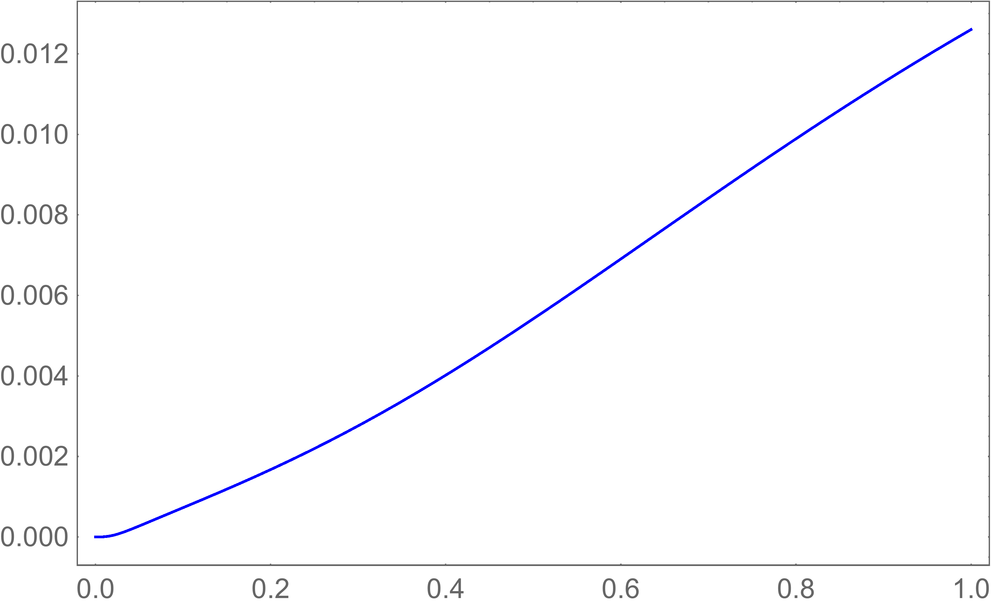
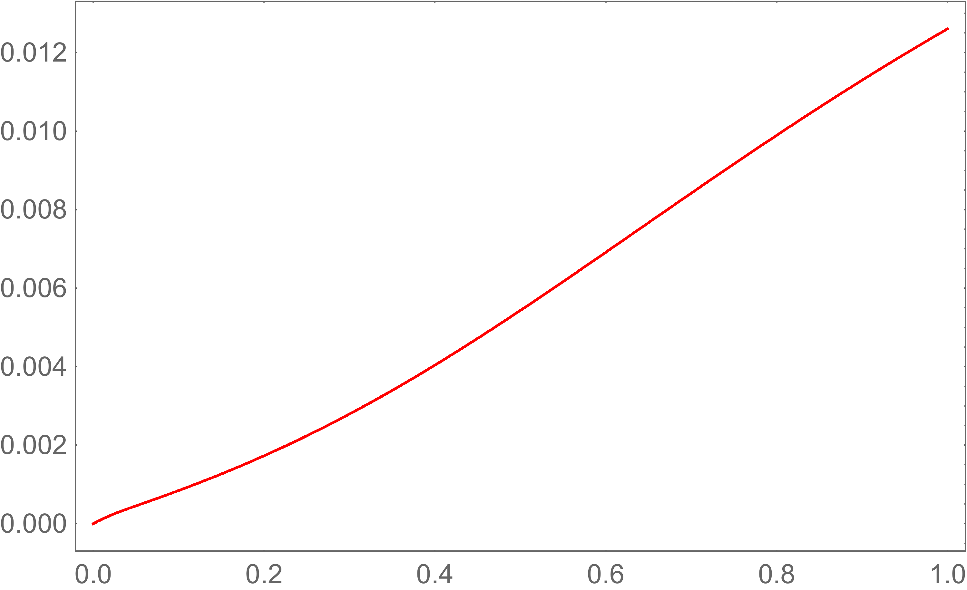
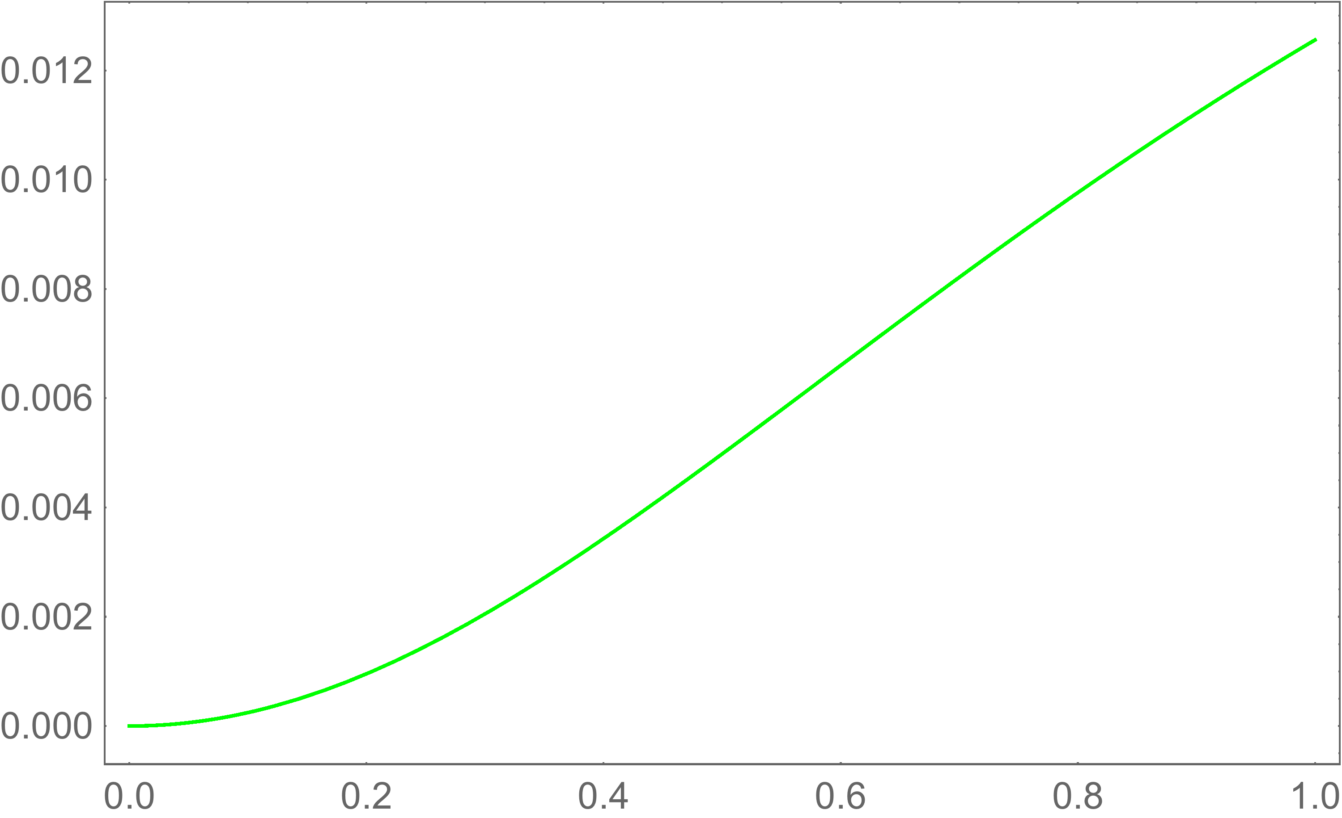
Possible observable signatures
: mixed state
: entangled state
: non-entangled state

Slide 21
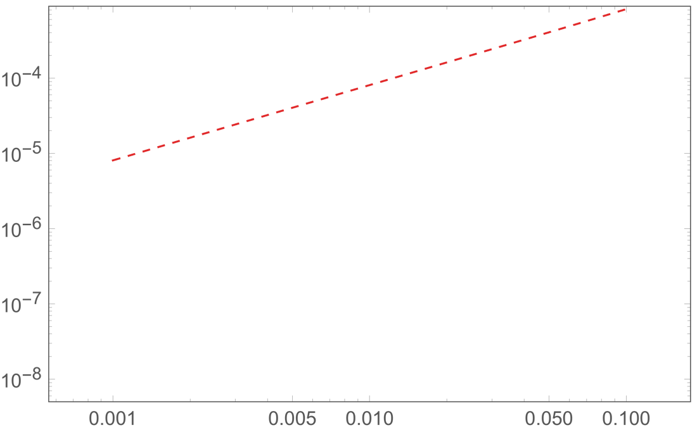
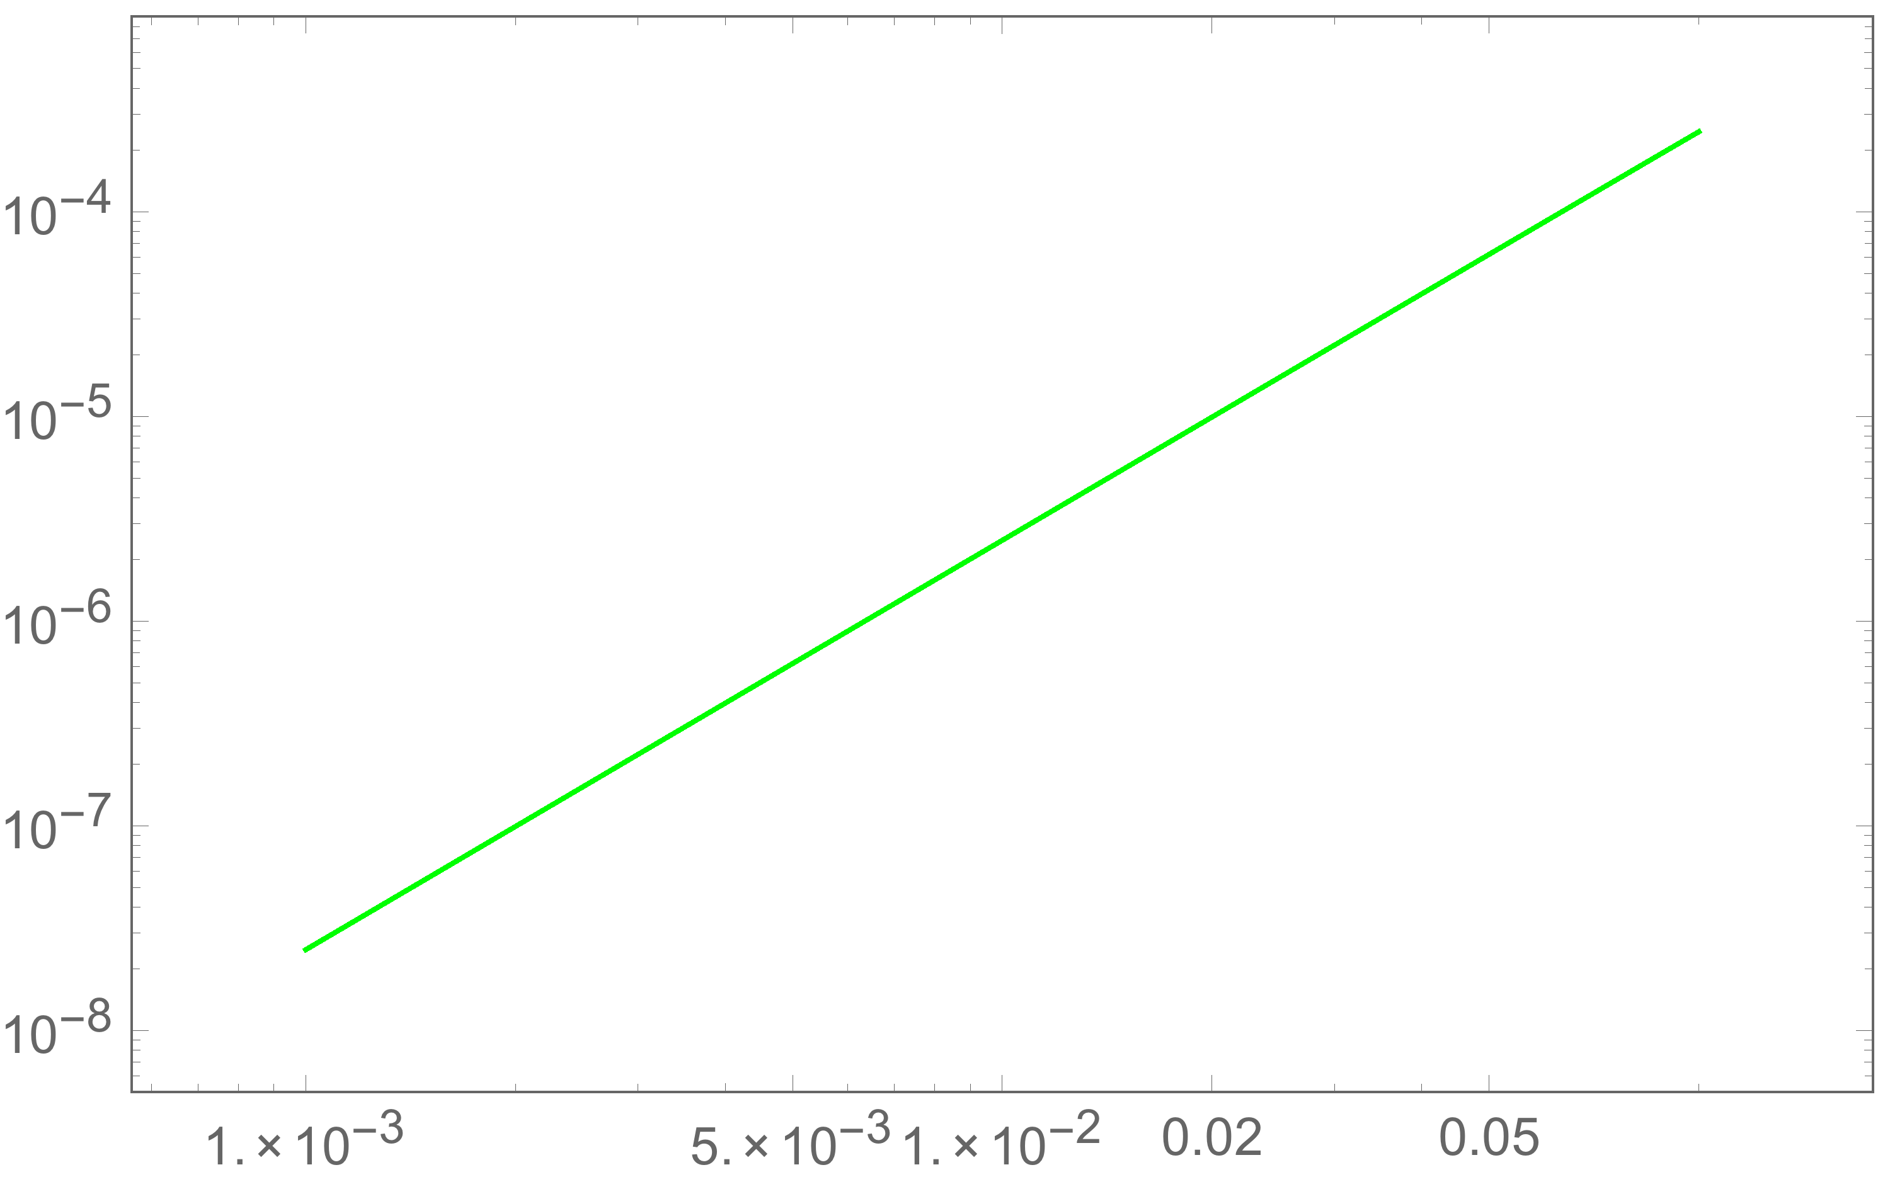
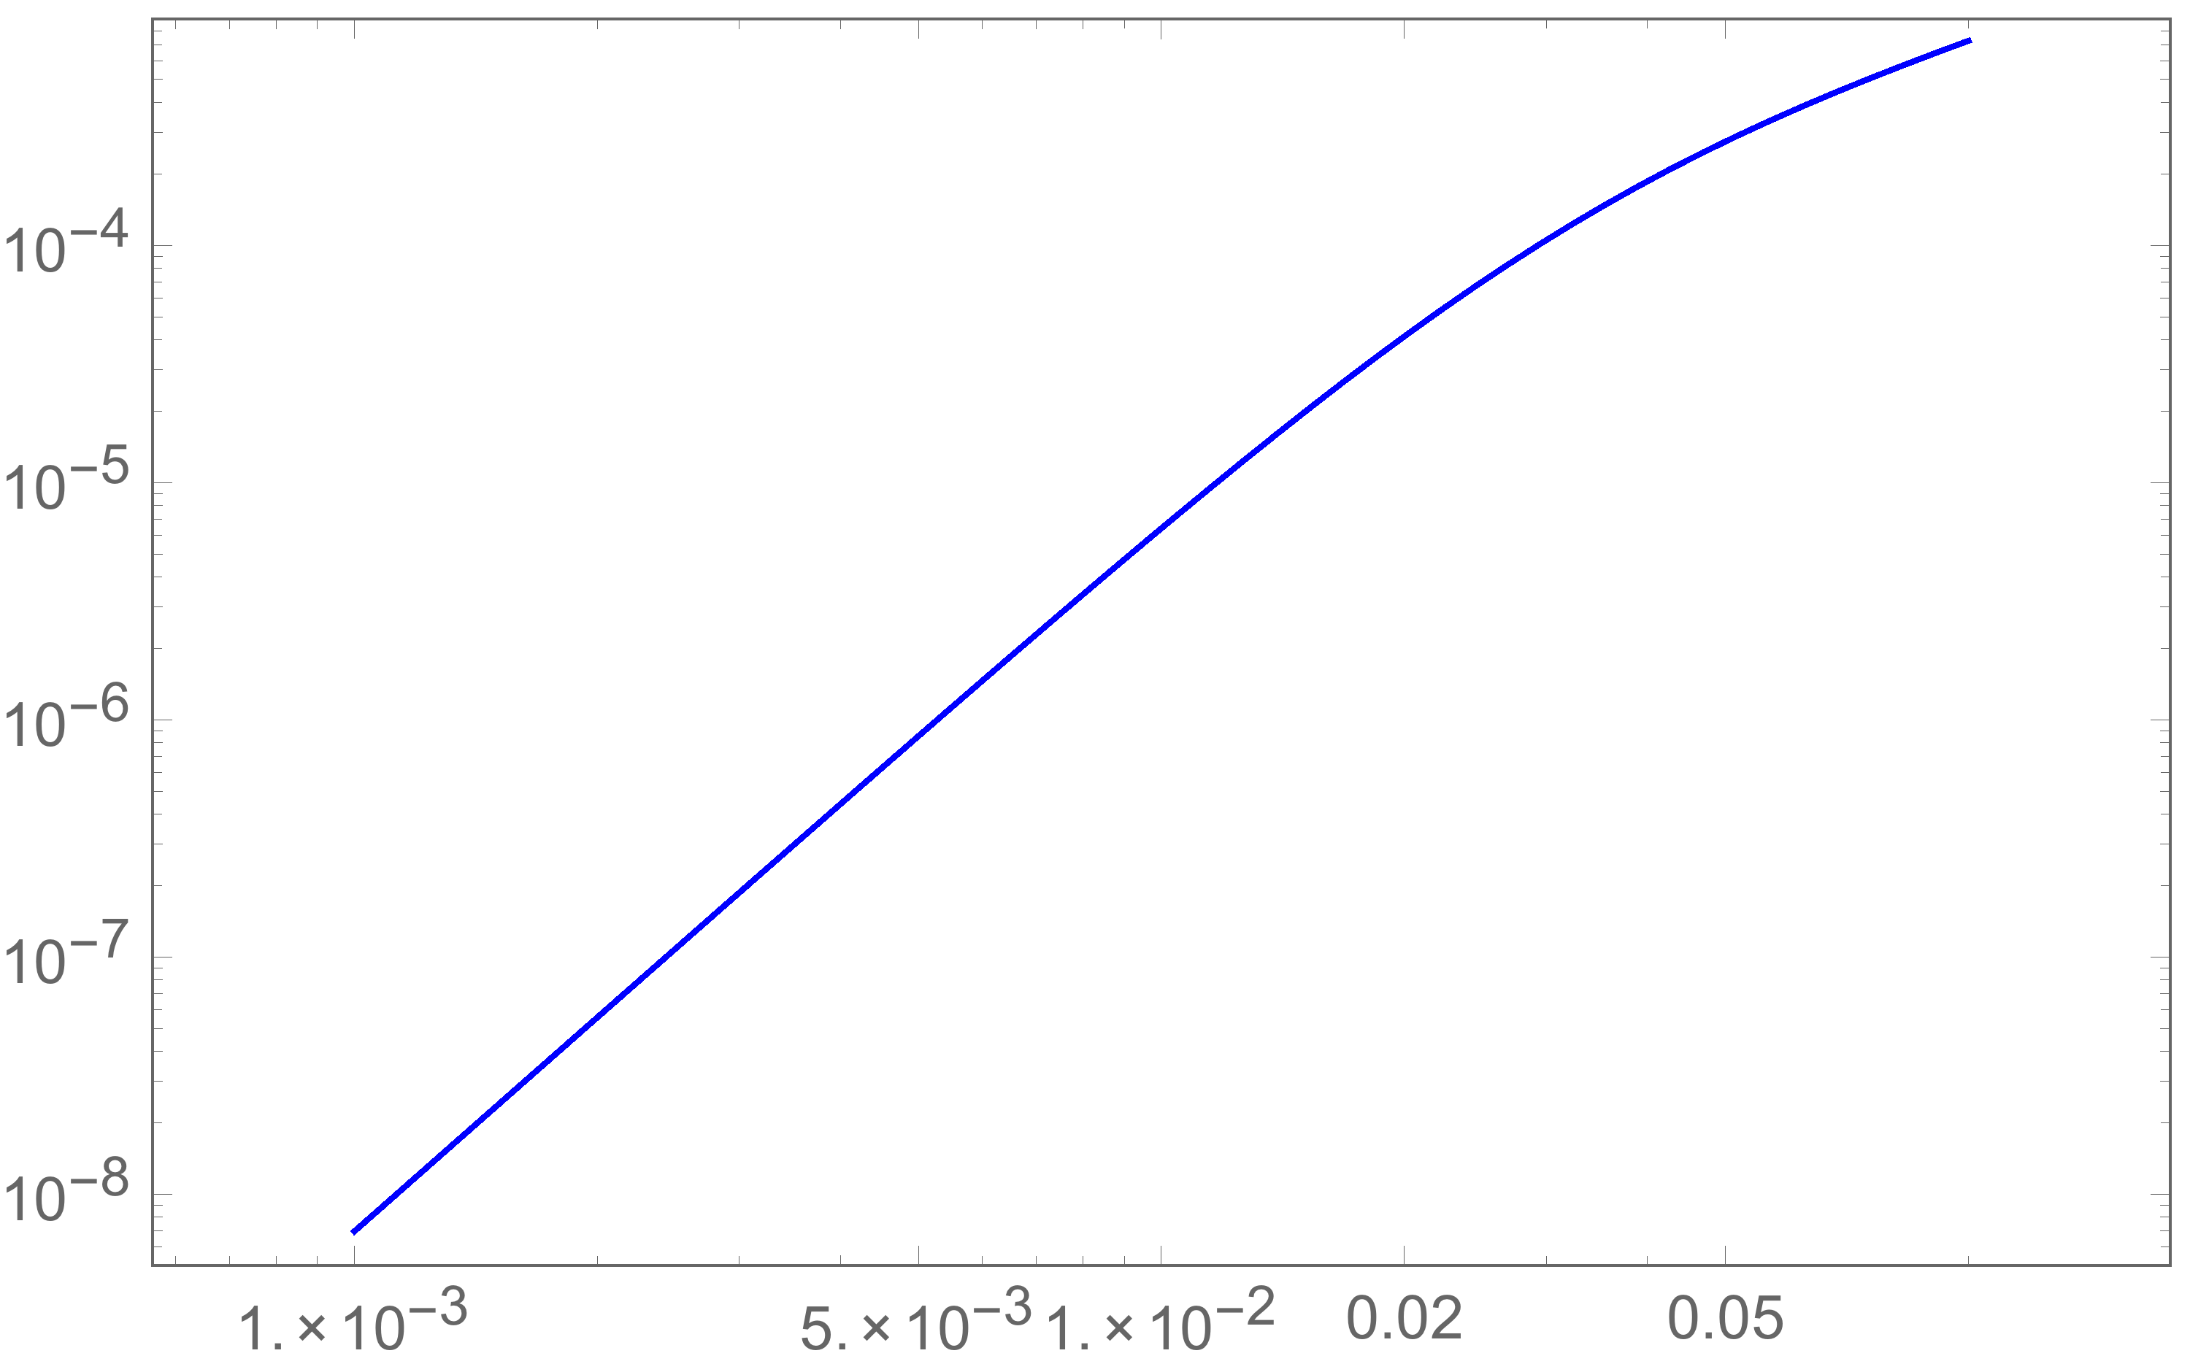
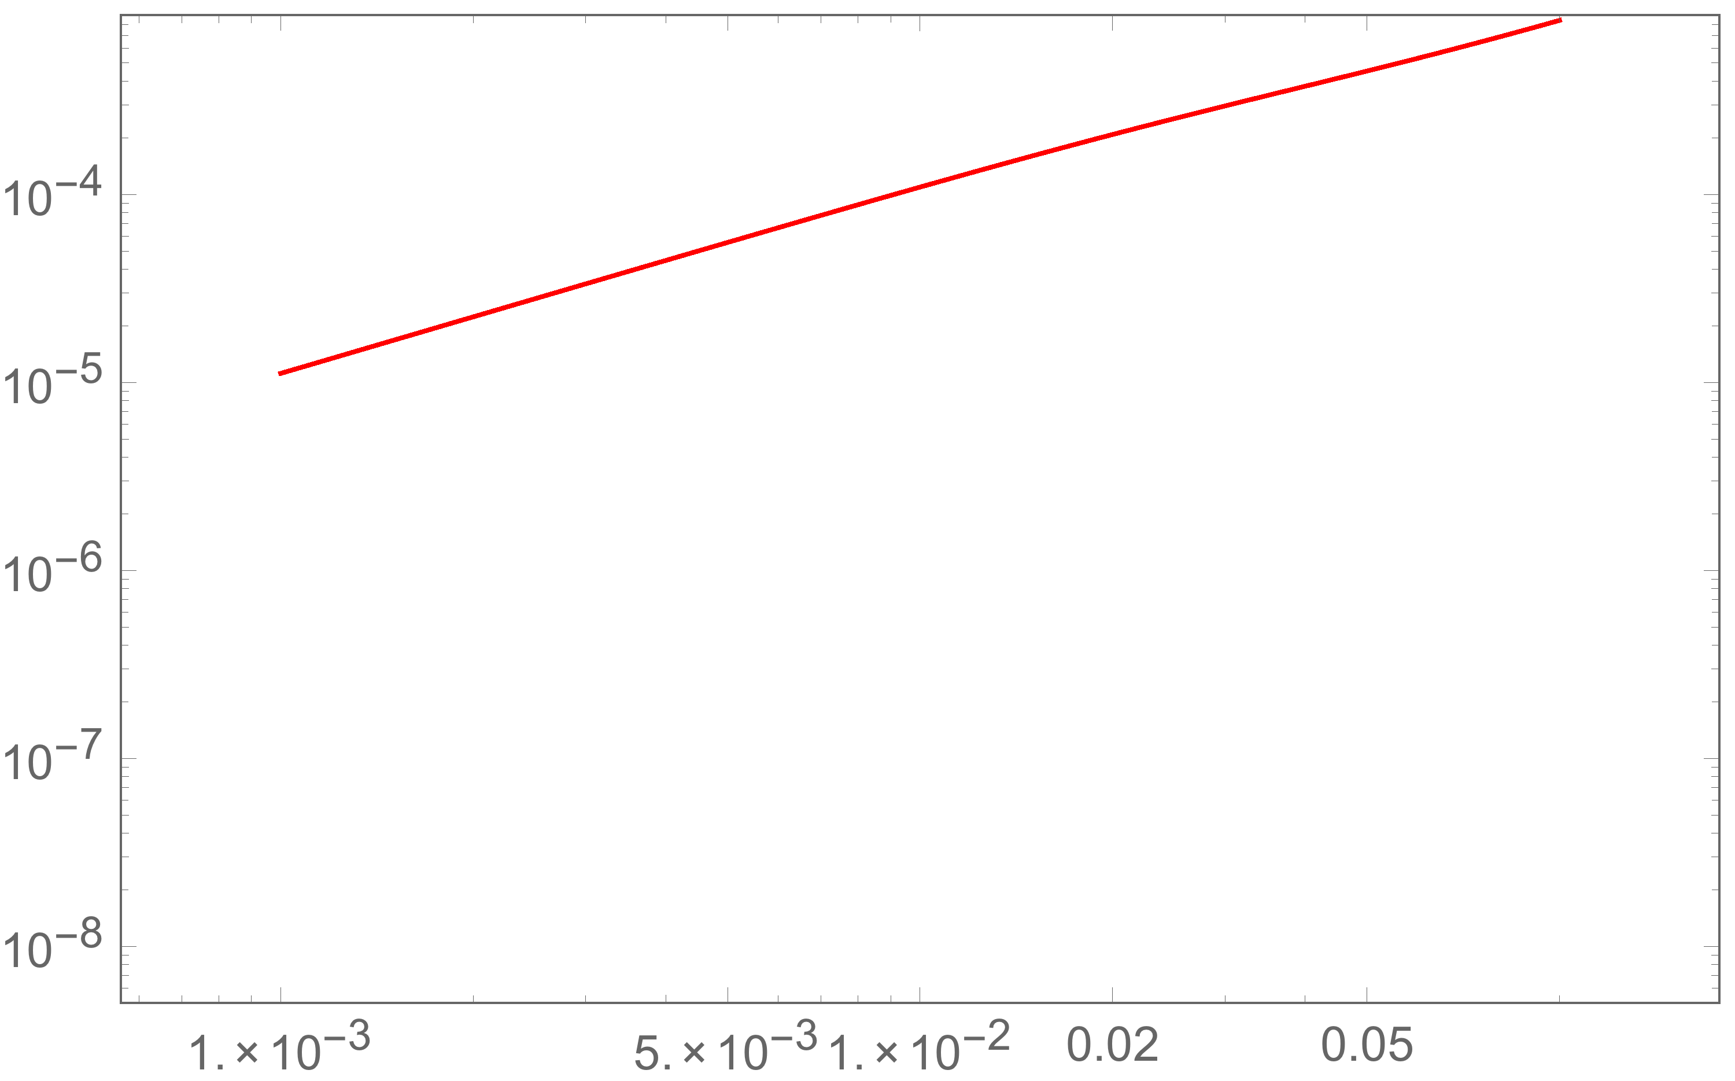
Possible observable signatures
: mixed state
: mixed state
: entangled state
: entangled state
: non-entangled state
20

Slide 22
Quantum entanglement affects the shape of the
spectrum on large scales comparable to or
greater than the curvature radius.
Can’t we find any signatures of entanglement
even on small scales?

Slide 23
Essence so far
Why entanglement didn’t appear on small scales?
The Bunch-Davies state is expressed as
No entanglement on small scales
The reason why entanglement appeared on large scales is…
The Bogoliubov transformation
Mix the operators with
If there was a situation that makes operators mixed as an initial state,
entanglement may appear even on small scales !?
Multiverse

Slide 24
Multiverse: String/cosmic landscape
The configuration space of all possible values of scalar fields together with the potential
Eternal inflation
Eternal inflation Chaotic inflation
Chaotic inflation
Tunneling
de Sitter multiverse
Causal diagram of the inflationary multiverse

Slide 25
Our universe may be nucleated as a state that
has an operator mixing with another universe !?
In fact, it is an initially entangled state

Slide 26
Truncation of an squeezed state
The vacuum state for BD1 and BD2
Let us consider a state defined by Bogoliubov transformations
This state is then written by
Truncation at the one particle state order
Standard description of composite system of an entangled state
The Bogoliubov coefficients corresponds to the degree of entanglement
The degree of entanglement depends on the wavenumber

Slide 27
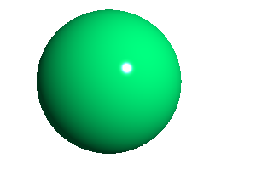
A pair of entangled universes
Initially entangled state
Kanno (2015)
: Maximally entangled state
BD1
BD2
: The Bunch-Davies vacuum
Expansion of space
Expansion of space
time
Initially entangled state
de Sitter multiverse
Causal diagram of the inflationary multiverse

Slide 28
The reduced density matrix in BD2
The reduced density matrix
Our quantum mechanical system becomes a mixed state by tracing out the
inaccessible BD1.
The reduced density matrix consists of only diagonal elements.

Slide 29
The spectrum of vacuum fluctuations in BD2
Shift
Shift

Slide 30
Initially non-entangled state
A direct product form
Extra two states contribute to the spectrum
The spectrum for the non-entangled state is the same as that of the entangled state?
No. Those off-diagonal elements survive as
That is, the one point function gives a non-zero value
We need to calculate the spectrum with the variance

Slide 31
The power spectrum for the non-entangled state
The variance
Need to subtract
The resultant spectrum becomes
Contribution from quantum interference
Contribution from the off-diagonal elements

Slide 32
Another example with two particle states
Initially entangled state
BD1
BD2
Expansion of space
Expansion of space
time
Initially entangled state
de Sitter multiverse
Causal diagram of the inflationary multiverse

Slide 33
The spectrum of vacuum fluctuations
Initially entangled state
Initially non-entangled state

Slide 34
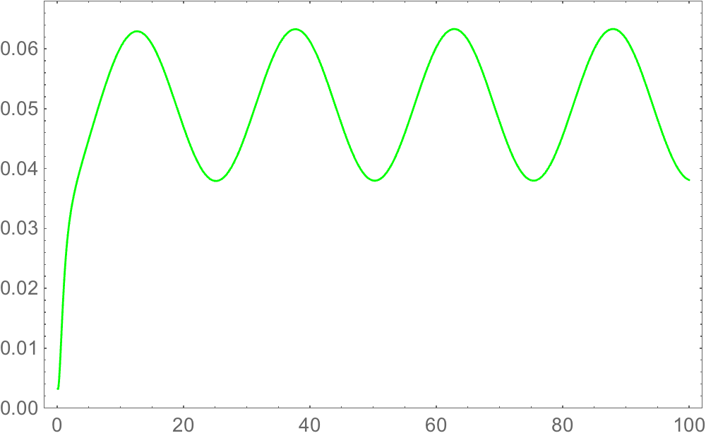
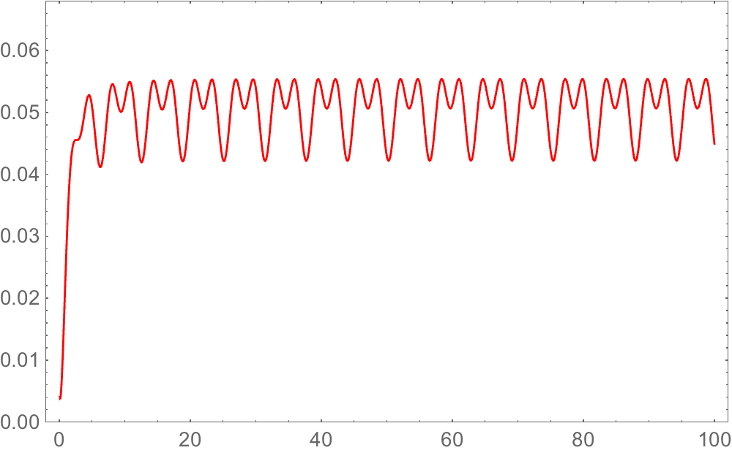
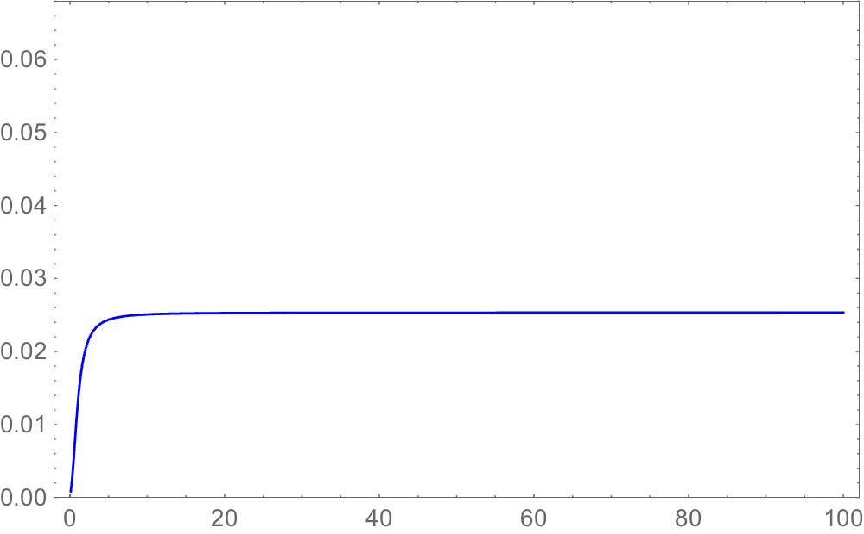
Oscillatory spectra

Slide 35
Summary
If our universe was nucleated in vacuum, the effect of entanglement
with another universe may appear on large scales comparable to or
greater than the curvature radius in the power spectrum, which could
be observationally tested in the near future.
If our universe was nucleated as an entangled state with another
universe initially, the effect of entanglement due to quantum interference
may be imprinted on the cosmological observables.
These give rise to the possibility that the existence of multiverse may
be experimentally tested in the near future.

